Slide 1
Blockchain technology
Prepared by: Aditya Singh
1816410025

Slide 2
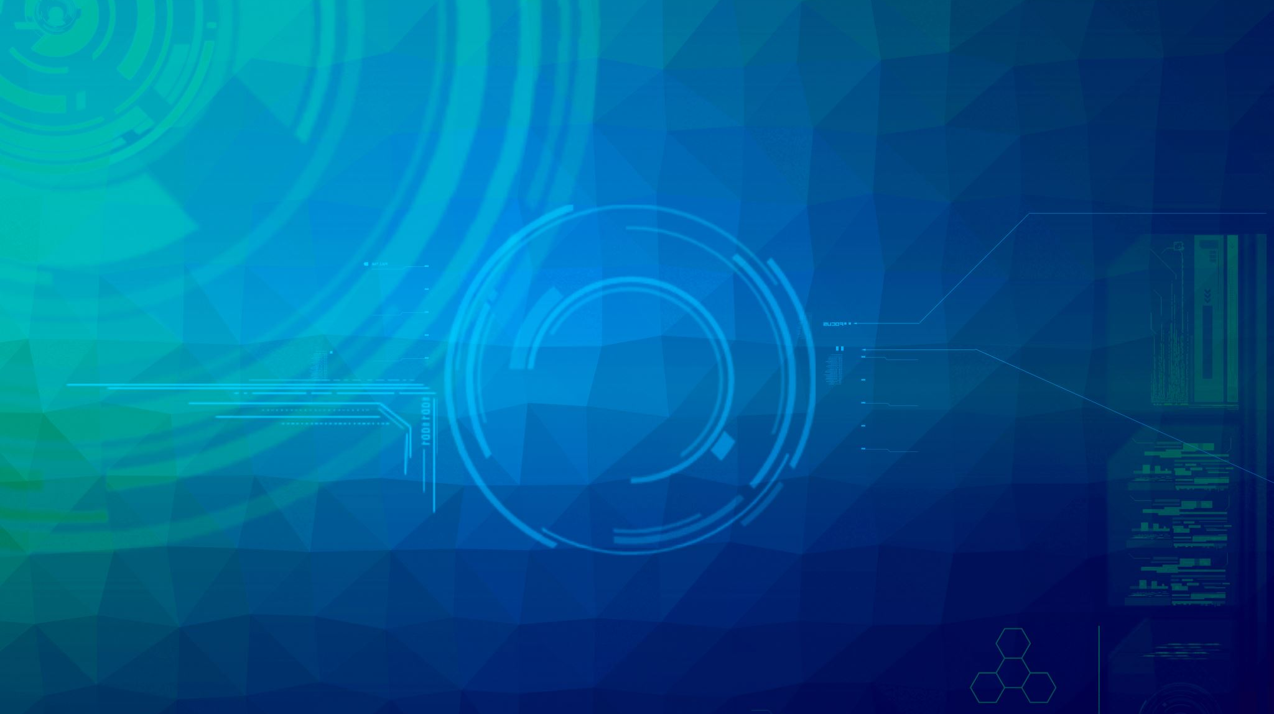
What is A Blockchain?
A blockchain is a growing list of data blocks that are linked together.
Data
Data
Data
Reference
Reference
Reference

Slide 3
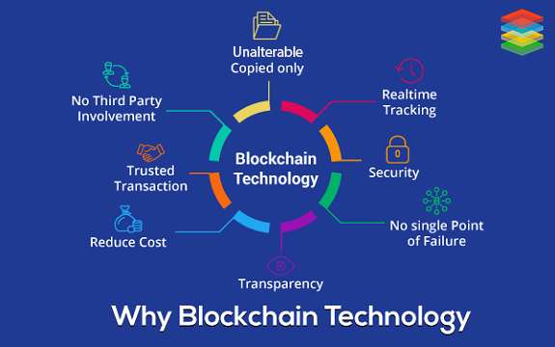

Slide 4
Key Features
Immutable records
Decentralized, no need for intermediaries
Consistent state across all participants
Distributed ledger technology
Open to everyone

Slide 5
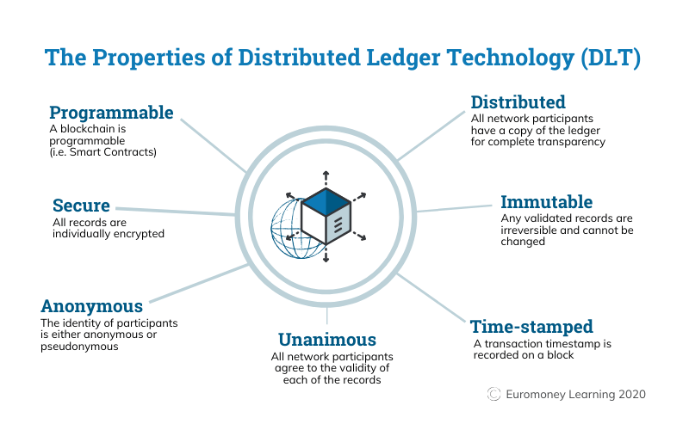
DISTRIBUTED LEDGER

Slide 6
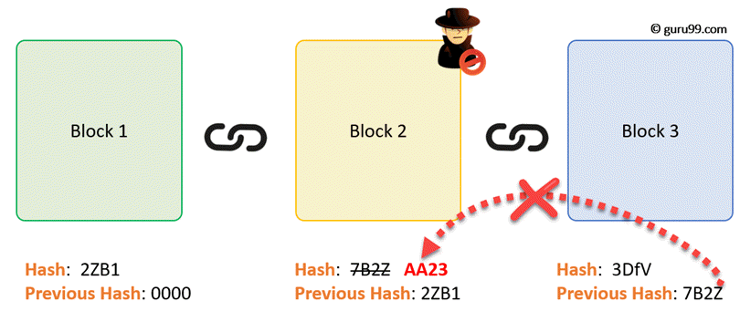
HOW BLOCKCHAIN WORKS ?
As each transaction occurs, it is recorded as a “block” of data
Each block is connected to the ones before and after it
Transactions are blocked together in an irreversible chain: a blockchain

Slide 7
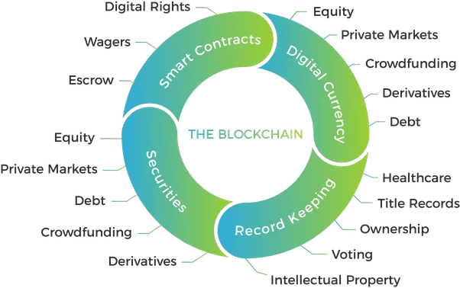
USE CASES
Cryptocurrencies
Financial Services
HealthCare
Supply Chains
Games

Slide 8


The history of Bitcoin
2008
Idea was published under the pseudonym Satoshi Nakamoto
2009
Start of the Bitcoin Network
2010
Fist cryptocurrency stock exchange is launched
2011
One Bitcoin equals one USD
2013
1 Bitcoin equals
100 USD

Slide 9
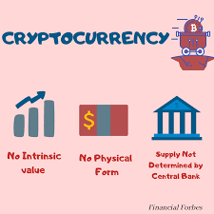
Bitcoin ≠ blockchain
Is an application of blockchain technology
Is the underlying data structure, which can be used for many things, including cryptocurrencies

Slide 10
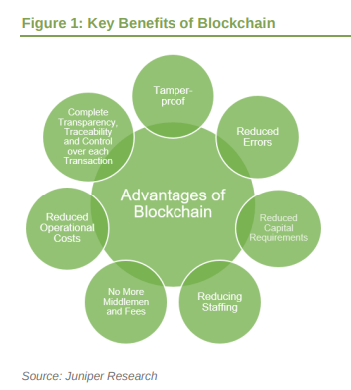
ADVANTAGES
Secure
No third party interference
Secure transactions
Instant transactions
Faster processing

Slide 11
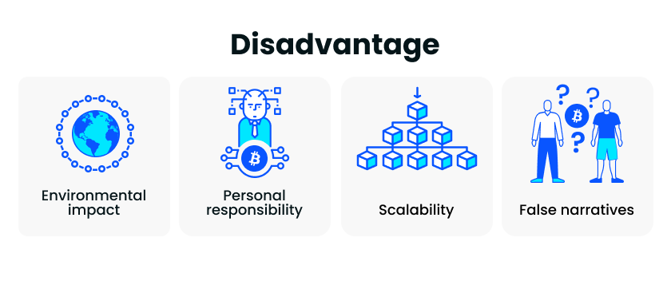


disadvantages
Cost
Lack of Standardization
Lack of Centralization
Regulation
Garbage in, garbage out
Over exuberance
Environmental impacts
Increased cyber threats

Slide 12
CONCLUSION
Blockchain could be used to securely and efficiently transfer user data across platforms and systems. The technology could also be used to maintain and protect records of real estate ownership, titles, and more.
Blockchain technology could change the world as it can get rid of all the inefficiencies of centralized systems. It brought decentralization into play. By using blockchain, any business improves its process to new heights.

Slide 13
THANK
YOU

